Slide 1
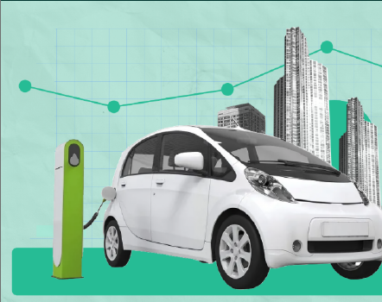
Agentic AI-Based Dynamic Tariff Optimization for EV Charging Networks Using Large-Scale Charging Session Data.
Anuj Mittal
23117025

Slide 2
DATA LANDSCAPE & PREPROCESSING
Data Sources
UrbanEV Dataset
Large-scale EV charging station operational dataset collected from charging infrastructure in China.
Contains station-level occupancy, charging volume, session duration, and pricing information.
Recorded at 5-minute intervals across multiple charging stations.
Used as the primary dataset for demand forecasting, tariff optimization, and monitoring.
ACN Dataset
Public EV charging session dataset collected from charging networks in the United States.
Contains connection, charging completion, and disconnection timestamps along with energy delivered.
Used to analyze user charging behavior, charger utilization efficiency, and idle occupancy patterns.
Data Preprocessing
UrbanEV
Converted wide-format station matrices into long-format observations.
Merged occupancy, volume, duration, and pricing datasets using Timestamp and Station ID.
Created a unified analytical dataset for modelling and optimization.
ACN
Removed incomplete charging sessions containing missing operational timestamps.
Retained only critical session-level variables required for behavioral analysis.

Slide 3
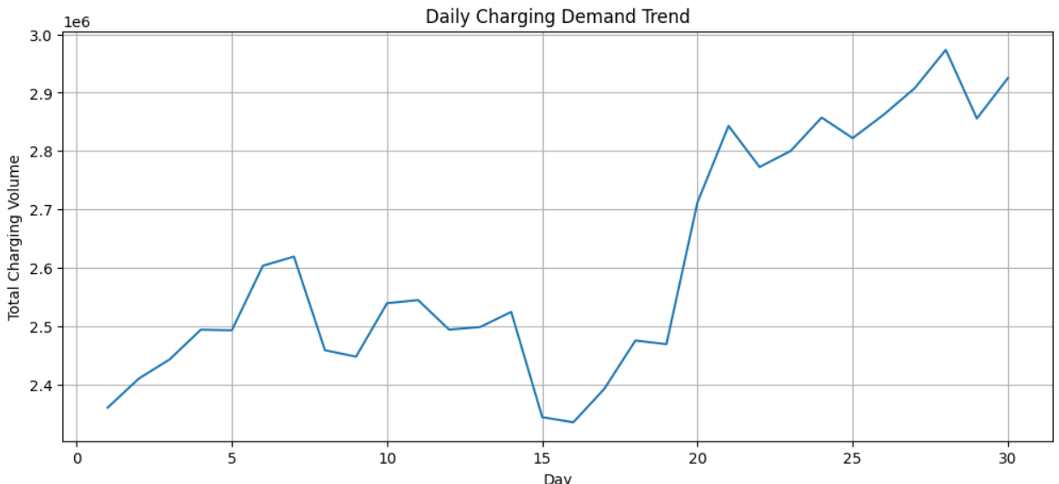
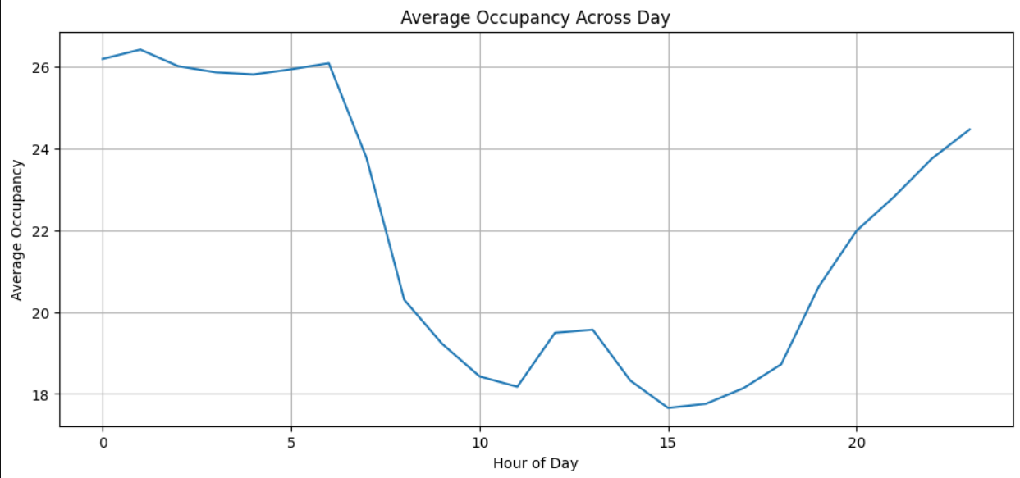
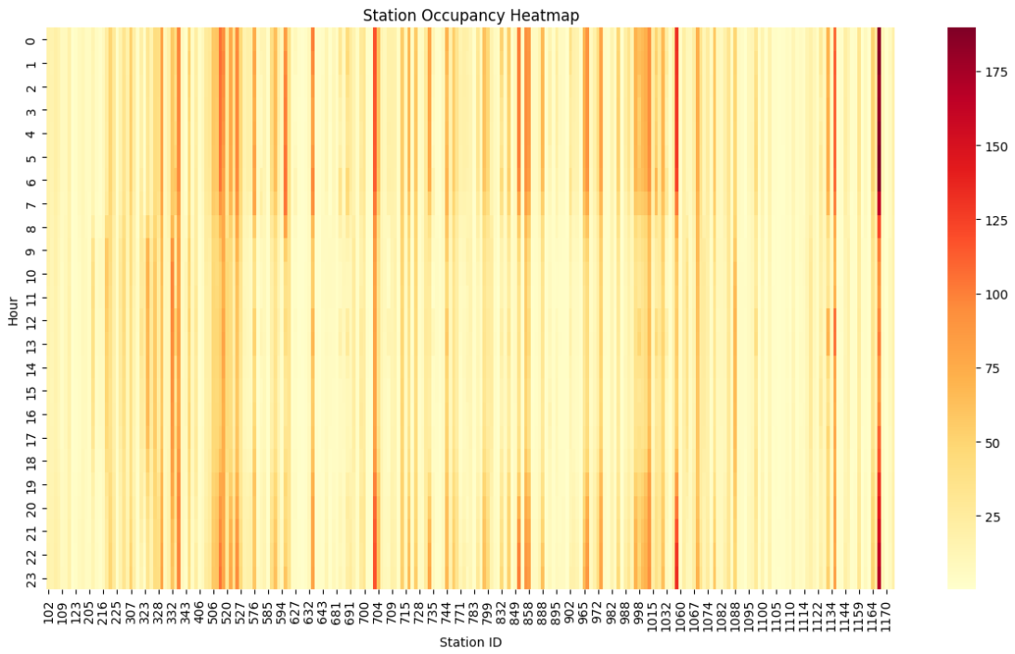
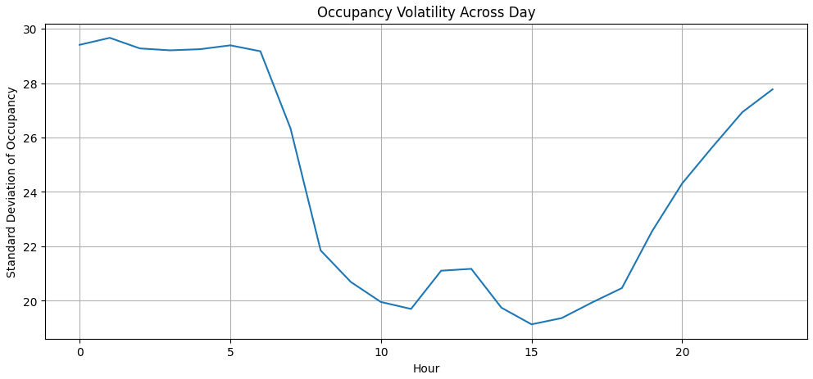
EDA & DEMAND BEHAVIOR INSIGHTS
Key Findings
Long-Term Demand Trend
Charging demand increased over the month
Demand dip observed around Day 15–16
Indicates evolving network utilization
Intraday Charging Behavior
Highest occupancy observed during late-night and early-morning hours
Lowest occupancy during midday
Congestion Characteristics
Significant variation across charging stations
Some stations consistently experience high utilization
Volatility Analysis
Occupancy variability highest during high-demand periods
Stable utilization observed during midday
Contrary to conventional assumptions, the network's peak utilization occurred during overnight hours. Therefore, peak periods were identified directly from data rather than predefined using human assumptions.

Slide 4
DEMAND PREDICTION AGENT
Predict future charging demand and station occupancy using historical operational features.
Features Used : Volume, Duration, Price, Charger Utilization Rate , Hour of Day
Target : Occupancy
Models Evaluated
Linear Regression - Baseline predictive model
Random Forest - Non-linear ensemble model
Model | MAE | RMSE | R²
Linear Regression | 4.498 | 7.557 | 0.907
Random Forest | 0.796 | 1.857 | 0.994
Interpretation
Linear Regression captured general trends.
Random Forest captured complex non-linear operational relationships.
Final Demand Prediction Agent used Random Forest.
Important Decision
Occupancy Density and Queue Length Proxy were excluded from modelling because they were derived from occupancy and would introduce target leakage.

Slide 5
DYNAMIC TARIFF PRICING AGENT
Translate demand forecasts into adaptive pricing decisions.
Pricing Logic
Surge Pricing : Applied when, Predicted Utilization > 80% ,Price Increase: +35%
Discount Pricing : Applied when, Predicted Utilization < 30%, Price Reduction: -5%
Customer Response Simulation
Assumptions:
High prices slightly reduce demand
Discounts encourage additional off-peak charging
Used as a proxy for demand elasticity
Metric | Result
Revenue Gain | +2.44%
Off-Peak Uplift | +8.0%
Utilization Before | 0.295
Utilization After | 0.323
Interpretation
Dynamic pricing successfully redistributed charging demand toward low-utilization periods while improving both revenue and charger utilization.

Slide 6
MONITORING & LEARNING AGENT
Evaluate the effectiveness of pricing decisions and create a feedback loop.
Metrics Tracked
Wait Time Reduction
Proxy for congestion reduction
Customer Response Rate
Measures demand shift after pricing changes
Pricing Efficiency Score
Revenue generated per unit charging activity
Metric | Result
Wait Time Reduction | 12.0%
Customer Response Rate | 5.24%
Pricing Efficiency Gain | -2.66%
Interpretation
Congestion reduced significantly
Users responded positively to pricing incentives
Slight efficiency tradeoff observed due to off-peak discounts
Key Insight
Dynamic pricing creates a tradeoff between operational efficiency and revenue efficiency. The proposed system prioritizes congestion mitigation while maintaining positive revenue growth.

Slide 7
BUSINESS, OPERATIONAL & POLICY IMPLICATIONS
Business Impact
Increased charging revenue
Improved charger utilization
Better asset efficiency
Operational Impact
Reduced congestion
Lower estimated waiting times
Improved load balancing across charging periods
Policy Implications
Supports sustainable EV infrastructure management
Encourages off-peak charging behavior
Reduces need for immediate infrastructure expansion
Demand Prediction Agent
↓
Tariff Pricing Agent
↓
Customer Response
↓
Monitoring & Learning Agent
↓
Continuous Optimization

Slide 8
CONCLUSION
Contributions
Unified multi-source EV charging datasets
Built Demand Prediction Agent
Built Dynamic Pricing Agent
Built Monitoring & Learning Agent
Developed closed-loop Agentic AI framework
Final Results
R² = 0.994
Revenue Gain = 2.44%
Off-Peak Uplift = 8%
Wait Time Reduction = 12%
Future Work
Real-time deployment
Reinforcement learning pricing policies
Weather and event-aware forecasting
Multi-city charging network optimization

Slide 9
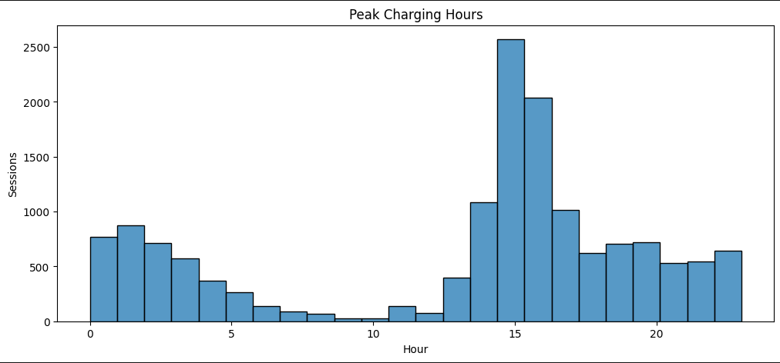
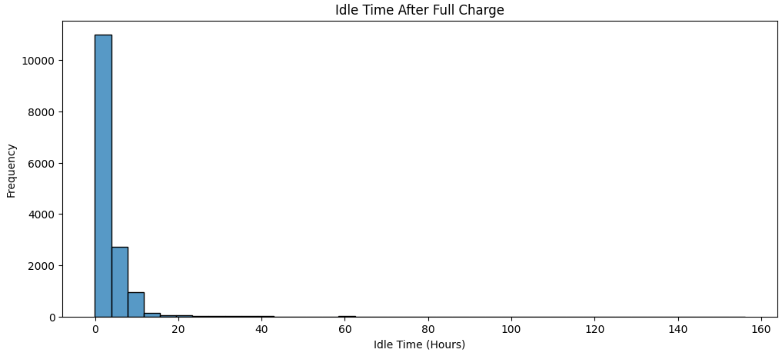
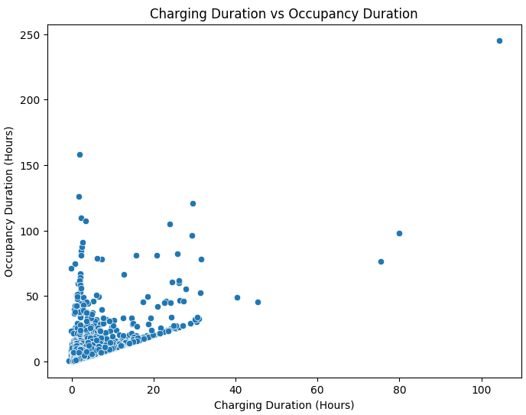
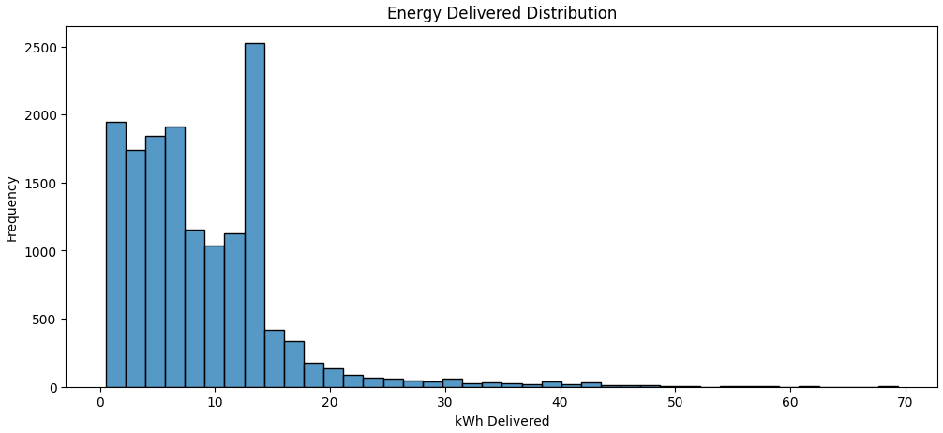
APPENDIX

Slide 10
Thank You

